Slide 1
  Core Java
  Inheritance
LEVEL – PRACTITIONER

Slide 2
Objectives
After completing this chapter you will be able to:
  Define Inheritance
  Explain need of inheritance
  Implement a subclass.
  Use of “super” keyword.
  How to override methods.
  Implement Run time polymorphism
  Describe method and field hiding.

Slide 3




Inheritance
Lets look at some model of phones that evolved in the past two decades. All the phones can be used to call friends(or anyone) and receive calls from them .
So how do they differ?
What is inheritance?
Basic Phone – People can talk
Smart Phone
People can,
Talk
Send SMS
Browse the Web
Take Photos/Videos
Cordless Phone
People can,
Talk
Mobile Phone
People can,
Talk
Send SMS
Each of them have INHERITED the common functionality talking from the ancestral basic phone and have some add-on features (SMS, Web browsing) of their own.
This is Inheritance.

Slide 4
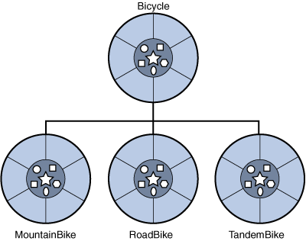
Inheritance
What is inheritance?
  Inheritance is the concept of a child class (sub class) automatically inheriting the variables and methods defined in a parent class (super class).
  It is one of the primary features of Object Oriented Programming
The super Class bicycle will hold all the common characteristics namely apply brake, pedalling
Here is another example,
Mountain bike has additional characteristics thick tyre.
Tandem bike has 2 seats & 2 handlebars.
Road bike has shock absorbers.

Slide 5
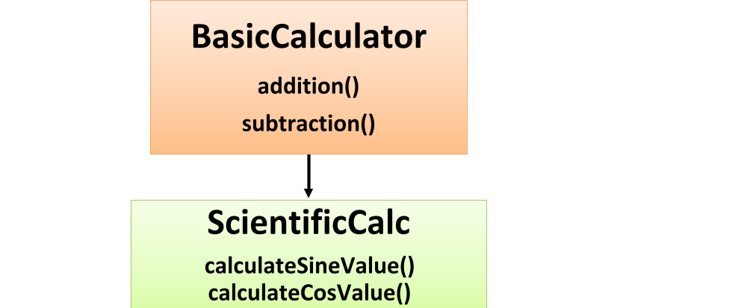
Benefits of Inheritance
Benefits of Inheritance:
  The primary benefit of inheritance is reusability.
  Once a behavior is defined in a super class, that behavior is automatically inherited by all its subclasses and reused. So developers need not redevelop the logic again.
  Example:
The ScientificCalc can calculate the sine and cos value and also perform addition and subtraction methods that it has inherited from BasicCalculator

Slide 6
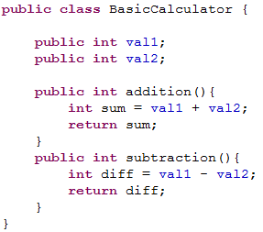
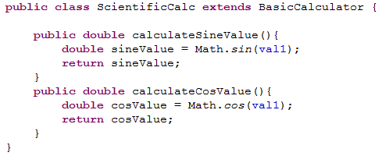
Extends Keyword
How to derive a subclass from parent class?
  To derive a sub class, you use the extends keyword.
Now you have to create another class called ScientificCalc which extends BasicCalculator so that you can inherit all methods of BasicCalculator
  Assume you have a parent class called BasicCalculator

Slide 7



Features of Subclass
Features of the subclass:
  A subclass inherits all of the “public” and “protected” members of its parent, no matter what package the subclass is in.
  If the subclass is in the same package, then it also inherits the “default” access (members that do not have any access modifier) members of the parent
Assume A.java is the parent Class, B is a subclass present in same package and D is a subclass in a different package
Same Package Another Package
B extends A A (parent class)
D extends A
Public protected default private

Slide 8
Inheriting fields in subclass
The inherited fields can be accessed directly, just like any other fields again based on the access modifiers.
  You can declare new fields in the subclass that are not in the super class.
  You can declare a field in the subclass with the same name as the one in the super class, thus hiding the parent fields (not recommended).
  A subclass does not inherit the private members of its parent class. However, if the super class has public or protected methods for accessing the private fields, these can also be accessed by the subclass.

Slide 9
Inheriting methods in a subclass
The inherited methods can be accessed directly just like any other methods in a class again based on the access modifiers.
  You can write a new instance of the method in the subclass that has the same signature as the one in the super class, thus overriding it.
  You can write a new static method in the subclass that has the same signature as the one in the super class, thus hiding it. Here, the super class method should also be static.
  You can declare new methods in the subclass that are not in the super class.

Slide 10
Object Class
Object class is mother of all classes, residing in “java.lang” package.
  In Java language, all classes are subclass (extended) of the Object super class.
  Object class does not have a parent class.
Object class implements behavior common to all classes including the ones that you write.
Following are some of the important methods of Object class,
  getClass() – Returns the runtime class of an Object.
  equals() – Compares two objects to check if they are the equal.
  toString() – Returns a String representation of the object.

Slide 11
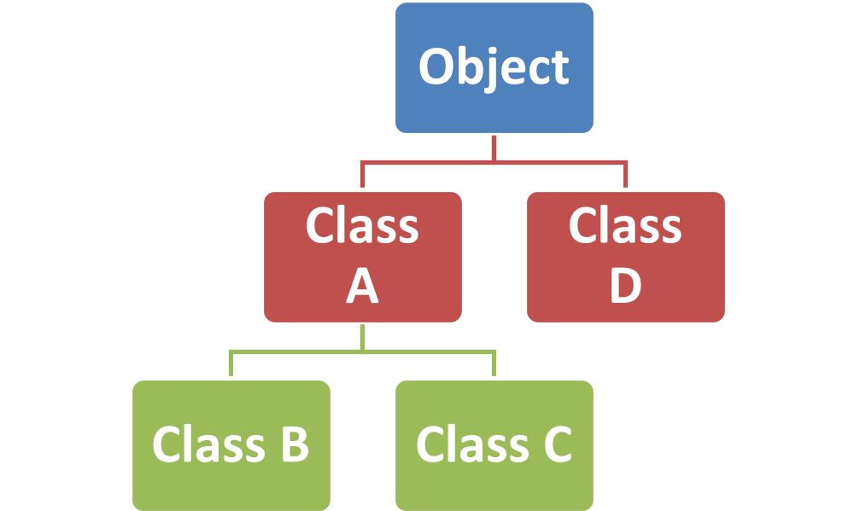
Super class and Sub class
What is a super class?
Any class preceding a specific class in the class hierarchy is the super class. It is also called as parent class.
What is a sub class?
Any class following a specific class in the class hierarchy.
Class A is the super class for Class B and Class C
Class B and Class C are the subclasses of Class A
Object Class is the super class for all classes

Slide 12
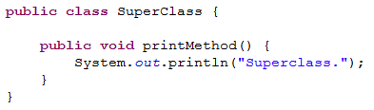
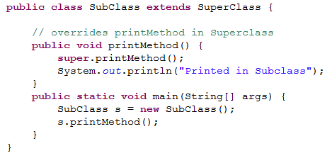
Super keyword
When is the super keyword used?
  The super keyword is used to access the variables and methods of super class
  If your method overrides one of it’s super class methods, you can invoke the overridden method through the keyword super
Example:
Invokes the super method in the super class

Slide 13
Super() Constructor
When is the super constructor used?
  The super constructor call is used to call a constructor of its immediate super class
  Based on the argument passed, the corresponding constructor in the parent class is invoked
Few things to remember:
  The super() call must occur as the first statement in the constructor
  The super() call can only be used in constructor calls and not method calls.

Slide 14
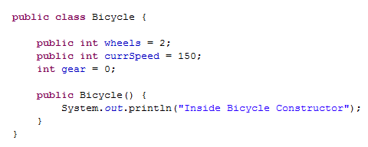
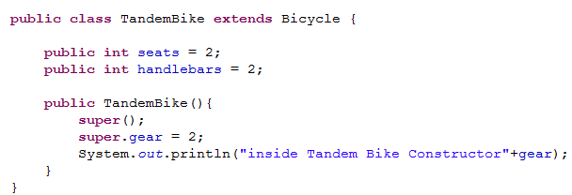
Lend a hand -Super constructor
Example:
  Create a main method and create an instance of TandemBike class to view the output
Super Class with default constructor
Super keyword to call the constructor in super class

Slide 15
Lend a hand - Inheritance
Problem Statement:
Create a class BankAccount with the following methods
  depositMoney – Prints the depositAmount.
  withdrawMoney – Prints the withdrawalAmount and calculates balance as mentioned below,
  balance = depositAmount – withdrawAmount
  The following instance variables need to be present in BankAccount
    withdrawAmount, depositAmount, interestRate (defaulted to 9.5) and balance.
Create two subclasses NRIAccount and SeniorCitizen account which extends the BankAccount class
  Both the subclasses should have a method called applyFixedDeposit which should set the interestRate variable in the super class to 6.5 for NRIAccount and 10.5 for SeniorCitizen account and display the interest rate message.
Create a class InheritanceDemo with main method which creates instance of the NRIAccount and SeniorCitizen Account and invokes the methods depositMoney(), withdrawMoney(), applyFixedDeposit()

Slide 16
Lend a hand – Inheritance Solution
Solution code:
Refer to the “Resources” section of this Session for the attachment “CodeSnippet_Inheritance.zip”
Import the zip file in SDE to look at the solution.

Slide 17


Behavior Overriding
Son is the subclass and he inherits the properties of the super class (father)
Father is the super class
Father likes to read books. His favorite genre is medical fiction
Son also likes to read books. His favorite genre is modern fantasy comics
Here, the son has inherited the father’s behavior of reading books, but with a difference in the type of book. Here the son is overriding the behavior of father.

Slide 18
Method Overriding
What is method overriding?
  Creating a method with the same name, arguments and return type in both the parent and the child class is called method overriding.
When do we override methods?
  If a derived class (sub class) needs have a different method implementation from that of a super class, then that method can be overridden.

Slide 19
Method Overriding - Example
Parent Class:
  public class Person{
      public String getName(){
        System.out.println(“Parent: getName”);
        return name;
      }
    }
getName method in the super class, Person
Now, when you invoke getName() method of an object of subclass (Student) , output would be,
Student:getName
Child Class:
  public class Student extends Person{
      public String getName(){
        System.out.println(“Student:getName”);
        return name;
      }
    }
getName method is overridden in subclass Student

Slide 20
Method Overriding
What is covariant return type?
    The overriding method in the sub class can also return a subclass of the return type of the overridden method (in parent class). This is called covariant return type.
Example:
public class Parent{
  public Person getPerson(){
    System.out.println("Parent:getName");
  return new Person();
  }
}
public class Child extends Parent{
  public Student getPerson(){
  System.out.println("Student:getName");
  return new Student();
  }
}
Child.getPerson() overrides the method Parent.getPerson() and has a covariant return type. Assuming Student is subclass of Person.
The overridden method returns Student which is a subclass of Person (return type of parent getPerson method).

Slide 21
Run Time Polymorphism
What is polymorphism?
Polymorphism is the capability of a method to do different things based on the object used for invoking the method..
What is run time polymorphism?
Method overriding is an example of runtime polymorphism. Here, the JVM determines the method invocation at the runtime and not at the compile time. The method being invoked is based on the object which on which the method is triggered.
From the previous Example,
Person p = new Person();
Person s = new Student();
p.getName()// will print “Parent getName”
s.getName()// will print “Student getName”
Based on the object on which the method is invoked the appropriate getName() method is called.

Slide 22
Lend a hand - Run Time Polymorphism
Let us all understand run time polymorphism with an example !!
  Let us create a parent class, Animal and three subclasses, Dog, Cow and Snake which extends Animal
  All the classes should have a method, whoAmI which prints the appropriate class name as “I am a Dog” (or) “I am a Cow” etc.
  A new class, RunTimePolymorphismDemo is created with a main method which creates an instance of all the classes created above and calls the whoAmI method for each instance.

Slide 23
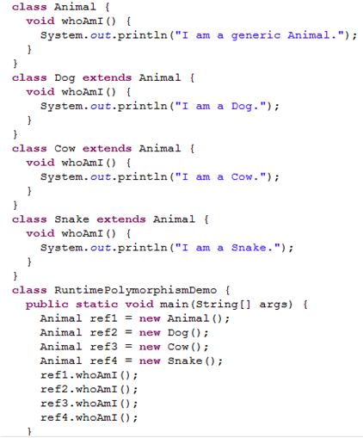

Lend a hand – Solution Run Time Polymorphism
Console Output
There are 4 variables of type Animal. Only ref1 refers to instance of Animal class, all other refers to instances of subclass of Animal. From the output’s result, we can see that the version of the method invoked is based on the actual object type

Slide 24
Hiding Methods
Hiding Methods :
  If a subclass defines a static method with the same signature as a static method in super class, then the method in subclass “hides” the one in super class.
  Hiding happens only when the method is a static method
Hiding Fields:
  Within a subclass, a field that has the same name as a field in the super class, hides the super class field even if their types are different.
  The super class field can only be accessed using the super keyword.
Hiding fields is not a recommended programming practice as it makes the code difficult to read.

Slide 25
Lend a Hand – Method Overriding
In the same bank example that we used for Inheritance, do the following changes
  Create a method, public void applyFixedDeposit() in the parent class, BankAccount.java which sets the interest rate at 8 and prints the deposit rates for a normal bank account
  In Inheritancedemo.java, change the object declarations of NRIAccount and SeniorCitizen account to the base class BankAccount. You will still notice that though the declaration has changed based on the object created the appropriate method will be invoked.
  In InheritanceDemo.java, create an instance of parent class (BankAccount.java) and invoke the applyFixedDeposit method. This will invoke the method in parent class BankAccount.java.

Slide 26
Lend a Hand – Method Overriding
  Solution:
Refer to the “Resources” section of this Session for the attachment “Code_Snippet_Overriding.zip”

Slide 27

Time To Reflect
Associates to reflect the following topics before proceeding.
What is Inheritance?
How to create a subclass?
What is the super class for all classes?
How to access the fields of the super class?
What is overriding?
What is run time polymorphism?

Slide 28
  Core Java
  You have successfully completed -
  Inheritance

